Slide 1
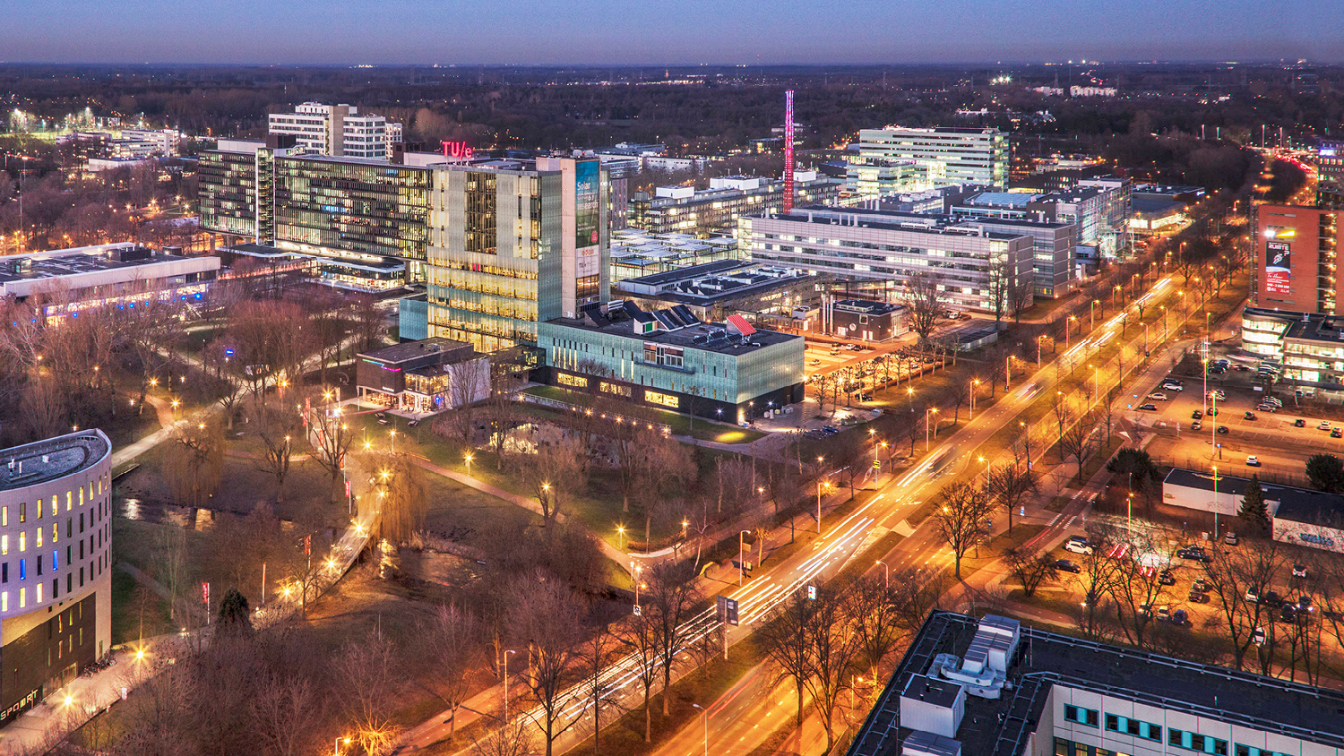
Deep Learning Under Attack: Revealing Vulnerabilities Through Shadow Reconstructions
July 2024
Thielen, Paul
Department of Mathematics and Computer Science

Slide 2
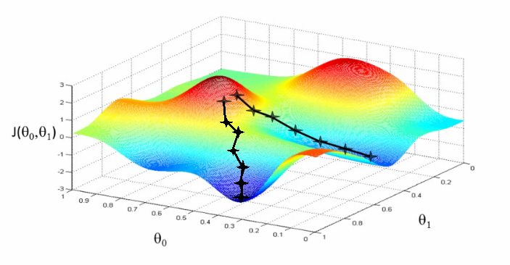





Background
MI Inversion: extracting information about the training data by analyzing the model’s predictions
Gradient based optimization
Second model acting as the inverse of original model
$$x$$
$$F_{w}$$
$$F_{w}(x)$$
$$G_{Θ}$$
$$\hat{x}$$
Source: Andrew Ng, Lecture 2 | Machine Learning Video
Notes:
This work will utilize both model inversion techniques.
Mention that they are in white box approach:
X is known and full access to F_w -> not realistic in real life
Gradient based optimization also assumes full access to F_w

Slide 3
Research Question
How do different factors influence the fidelity of image reconstruction using TCNNs within a non-white box framework? Specifically:
RQ1: How do variations in input combinations to the TCNN, including output vector, gradient reconstruction, and last linear layer activations, impact reconstruction quality?
RQ2: How do defensive mechanisms, like truncation and output vector rounding, affect the quality of the reconstructed images?

Slide 4
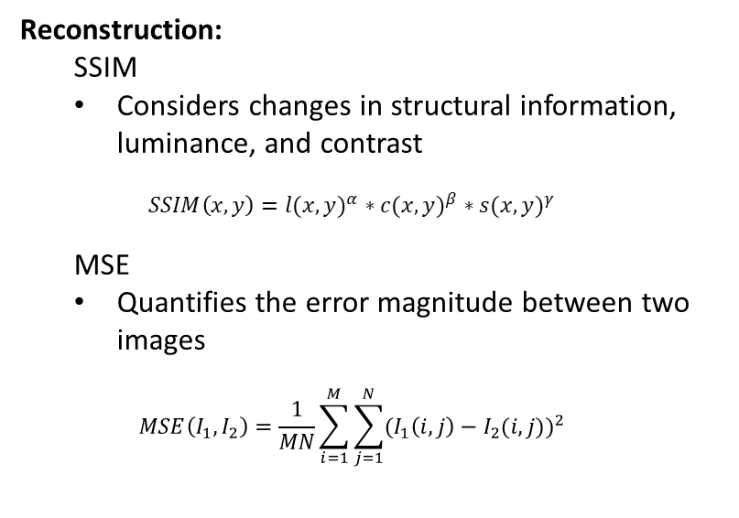



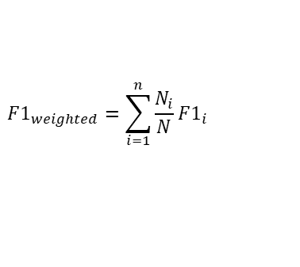
Evaluation Metrics
Classification:
F1-score
The harmonic mean of precision and recall
Reconstruction:
SSIM
Considers changes in structural information, luminance, and contrast
$$SSIM\left(x,y\right)=l(x,y)^{α}∗c(x,y)^{β}∗s(x,y)^{γ}$$
MSE
Quantifies the error magnitude between two images
$$MSE\left(I_{1},I_{2}\right)=\frac{1}{MN}\sum_{i=1}^{M}{\sum_{j=1}^{N}{{(I_{1}\left(i,j\right)−I_{2}(i,j))}^{2}}}$$
$$F1_{weighted}=\sum_{i=1}^{n}{\frac{N_{i}}{N}F1_{i}}$$
$$F1_{i}=2∗\frac{Precision_{i}∗Recall_{i}}{Precision_{i}+Recall_{i}}$$
$$Recall=\frac{TP}{TP+FN}$$
$$Precision=\frac{TP}{TP+FP}$$

Slide 5
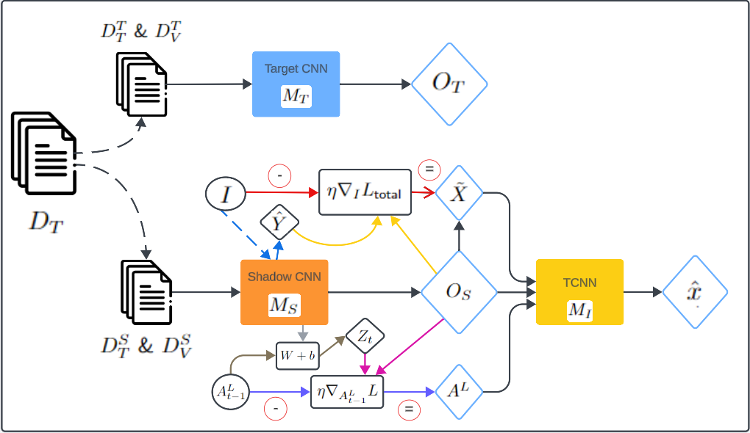
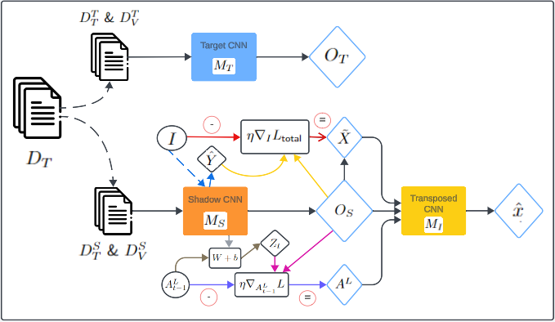
Workflow - Training

Slide 6
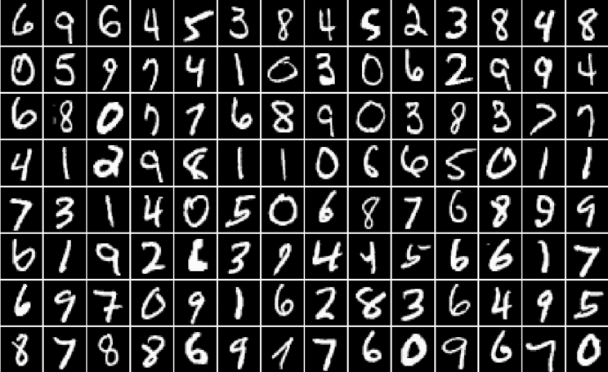
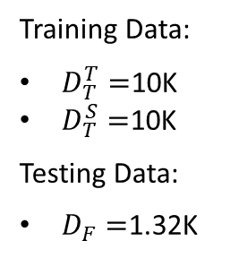
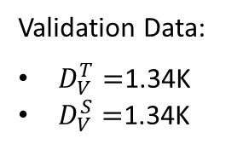
MNIST Dataset
grayscale images Labeled with digits 0-9
24k images – 2,400 images per class
Reshaped from 28x28 to 32x32
Training Data:
$D_{T}^{T}=$10K
$D_{T}^{S}=$10K
Testing Data:
$D_{F}=$1.32K
Validation Data:
$D_{V}^{T}=$1.34K
$D_{V}^{S}=$1.34K

Slide 7
Workflow - Training

Slide 8
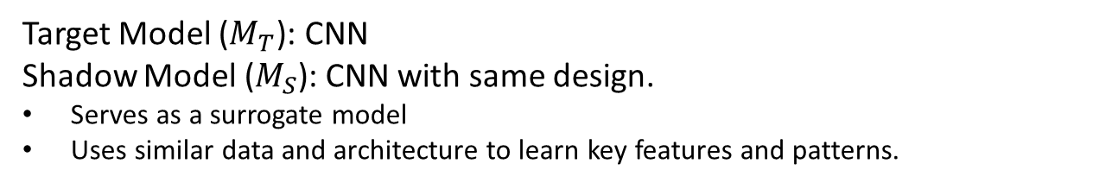
Target and Shadow Model
Target Model ($M_{T}$): CNN
Shadow Model ($M_{S}$): CNN with same design.
Serves as a surrogate model
Uses similar data and architecture to learn key features and patterns.
CNN Architecture
Input
Output
Linear
Conv
ReLU
Linear
Max-Pool
Batch Norm
Conv
ReLU
Max-Pool
Conv
ReLU
Batch Norm
Max-Pool
Batch Norm

Slide 9
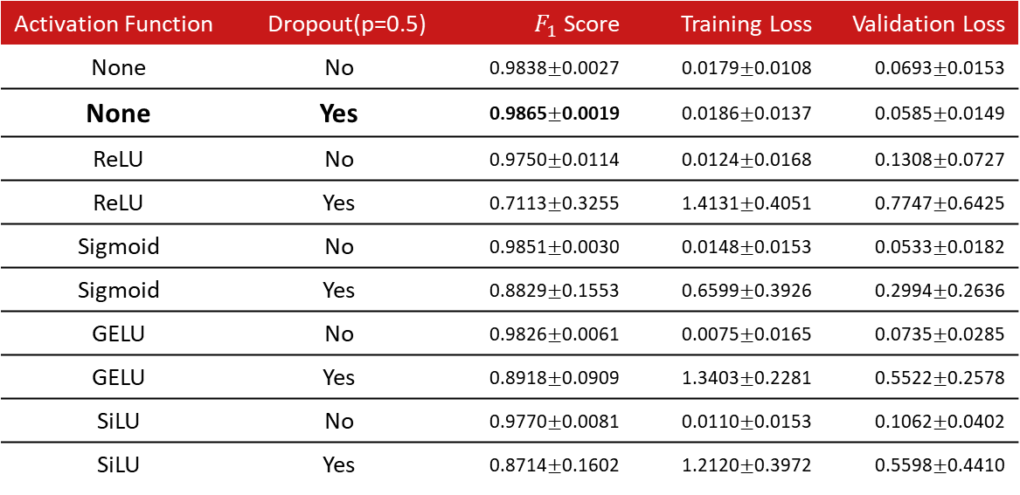
Impact of Activation Function and Dropout on Model Performance
Activation Function | Dropout(p=0.5) | $F_{1}$ Score | Training Loss | Validation Loss
None | No | 0.9838$±$0.0027 | 0.0179$±$0.0108 | 0.0693$±$0.0153
None | Yes | 0.9865$±$0.0019 | 0.0186$±$0.0137 | 0.0585$±$0.0149
ReLU | No | 0.9750$±$0.0114 | 0.0124$±$0.0168 | 0.1308$±$0.0727
ReLU | Yes | 0.7113$±$0.3255 | 1.4131$±$0.4051 | 0.7747$±$0.6425
Sigmoid | No | 0.9851$±$0.0030 | 0.0148$±$0.0153 | 0.0533$±$0.0182
Sigmoid | Yes | 0.8829$±$0.1553 | 0.6599$±$0.3926 | 0.2994$±$0.2636
GELU | No | 0.9826$±$0.0061 | 0.0075$±$0.0165 | 0.0735$±$0.0285
GELU | Yes | 0.8918$±$0.0909 | 1.3403$±$0.2281 | 0.5522$±$0.2578
SiLU | No | 0.9770$±$0.0081 | 0.0110$±$0.0153 | 0.1062$±$0.0402
SiLU | Yes | 0.8714$±$0.1602 | 1.2120$±$0.3972 | 0.5598$±$0.4410

Slide 10
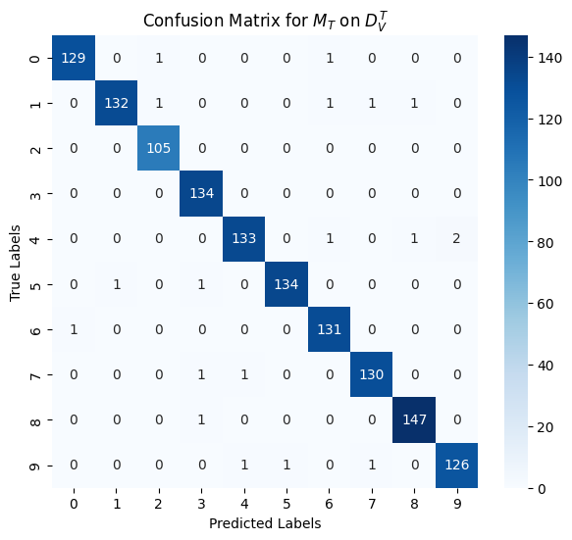
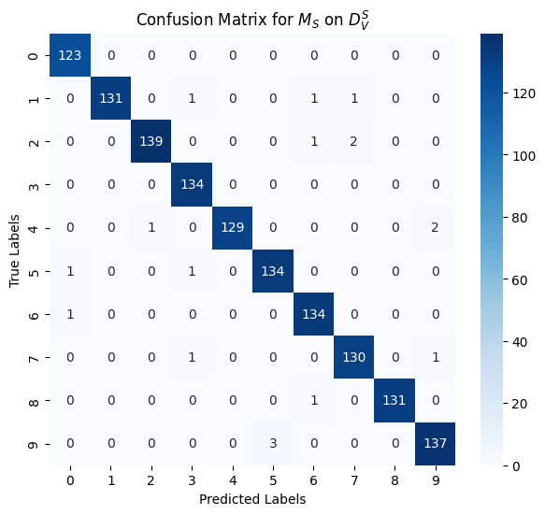
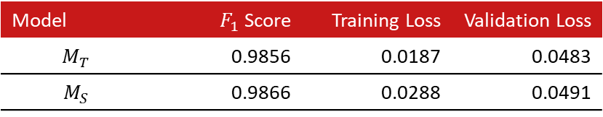
Final Target and Shadow Model
Model | $F_{1}$ Score | Training Loss | Validation Loss
$$M_{T}$$ | 0.9856 | 0.0187 | 0.0483
$$M_{S}$$ | 0.9866 | 0.0288 | 0.0491

Slide 11
Workflow - Training

Slide 12
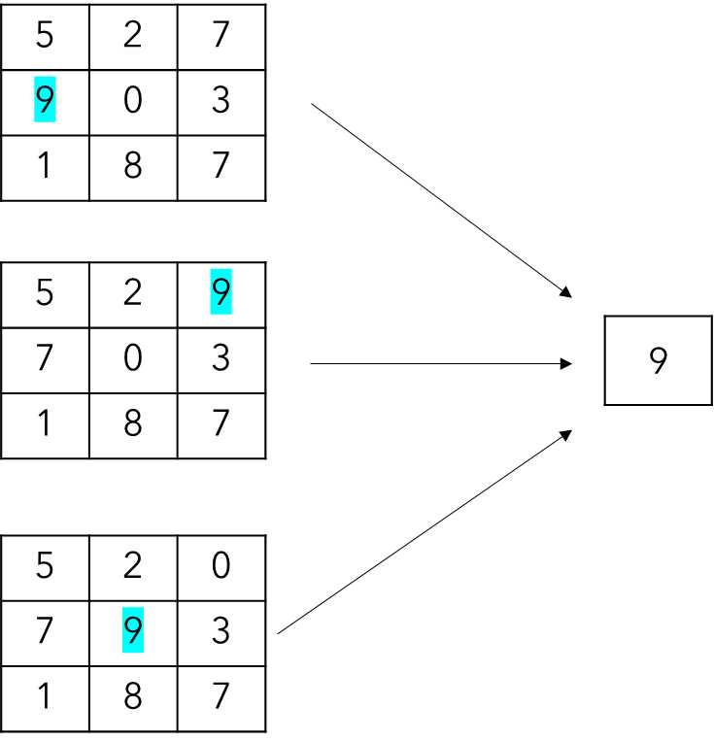
Why TCNN?
CNNs use max-pooling to reduce spatial dimensions while retaining maximum values
Max-pooling -> Coordinate Transform Problem
Exact location of maximum value is lost
Subsequent layers lose feature location info
Cause blur or distortion in gradient reconstructions

Slide 13
TCNN
Approx. learn to reverse the pooling operations used by CNN
Maintain spatial information
SSIM as loss function
TCNN Architecture
Input
Output
Trans-Conv
Trans-Conv
Sigmoid
ReLU
Batch Norm
Trans-Conv
ReLU
Batch Norm
Trans-Conv
ReLU
Batch Norm

Slide 14
Workflow - Training

Slide 15
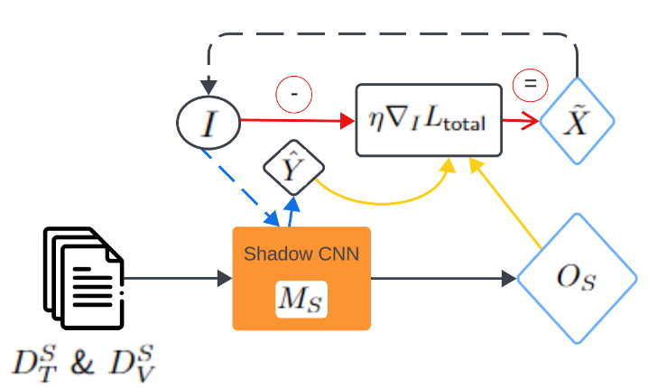
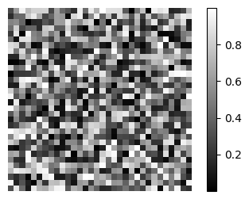
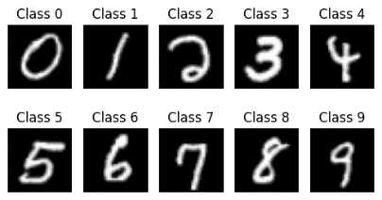
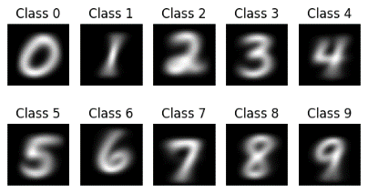

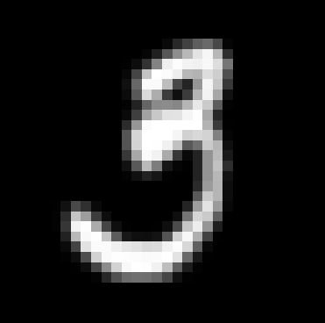

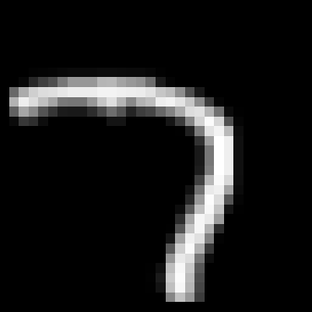
Gradient Reconstructions
Starting points:
Update Rule:
Random Pixels
Specific Class Instance
Class Average
Examples:
Reconstruction
Target
Reconstruction
Target

Slide 16




Gradient Reconstructions
 | Shadow Validation Set |  | Test Set
Description | SSIM | MSE | SSIM | MSE
Random Pixels | 0.0536 ± 0.0081 | 0.1032 ± 0.0042 | 0.0417 ± 0.0065 | 0.1136 ± 0.0047
Specific Class Instance | 0.2476 ± 0.0138 | 0.0687 ± 0.0078 | 0.1846 ± 0.0141 | 0.0778 ± 0.0084
Class Average | 0.3014 ± 0.0079 | 0.0601 ± 0.0037 | 0.2409 ± 0.0068 | 0.0672 ± 0.0021
Target Images (Test Set)
Random Pixels
Specific Class Instance
Class Average

Slide 17
Workflow - Training

Slide 18
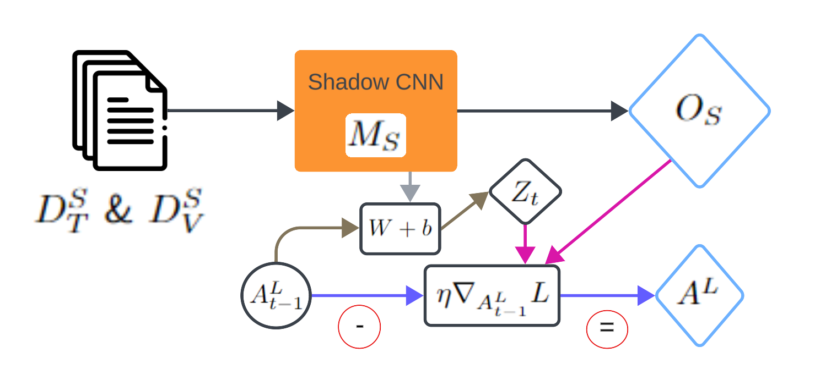



Last Linear Activations
$$A^{L}$$
$$Z_{t}$$
7.4521
-4.523
2.789
1.264
…
…
…
9.214
-0.178
4.231
0.721
-0.816
2.345
-1.523
0.789
1.234
-0.912
3.456
-2.178
0.543
1.789
-0.432
Update Rule:
$$W+b$$

Slide 19
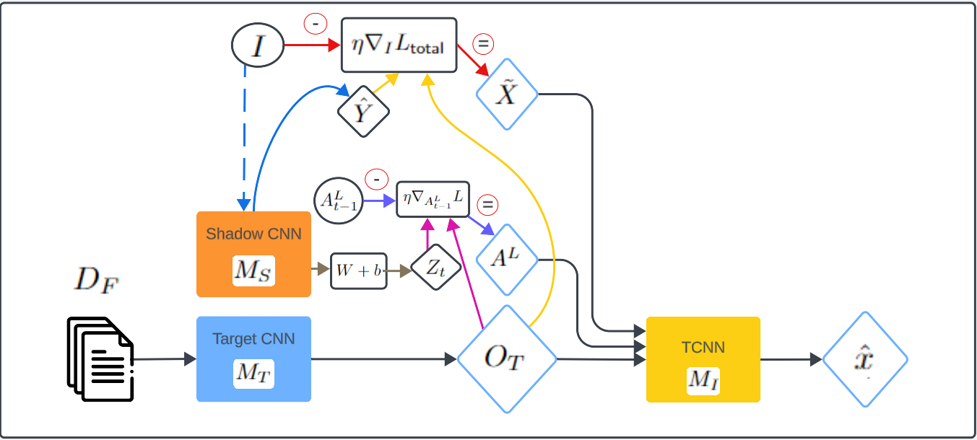

Workflow - Testing

Slide 20






















RQ1: Best Model Configuration
$M_{I}\left({\text{A}}^{L}\right)$
Model
SSIM
MSE
Target
$M_{I}\left(\text{O}\right)$
0.2298
±
0.0041
0.0966
±
0.0011
$M_{I}\left({\text{A}}^{L}\right)$
0.1218
±
0.0043
0.1077
±
0.0014
$M_{I}\left(\tilde{X}\right)$
0.3727
±
0.0030
0.0649
±
0.0009
Reconstructions
$M_{I}\left(\text{O}+{\text{A}}^{L}\right)$
0.1619
±
0.0027
0.1055
±
0.0016
$M_{I}\left(\text{O}+\tilde{X}\right)$
0.2467
±
0.0013
0.0904
±
0.0013
$M_{I}\left({\text{A}}^{L}+\tilde{X}\right)$
0.1822
±
0.0051
0.0961
±
0.0012
$M_{I}\left({\text{O}\text{+ }\text{A}}^{L}+\tilde{X}\right)$
0.2194
±
0.0016
0.0927
±
0.0011

Slide 21
RQ2: Effect of Output Vector Rounding
Output
Rounded
2.345
-1.523
0.789
1.234
-0.912
3.456
-2.178
0.543
1.789
-0.432
2.3
-1.5
0.8
1.2
-0.9
3.5
-2.2
0.5
1.8
-0.4

Slide 22


RQ2: Effect of Output Vector Rounding
Non
-
Non-Rounded
Rounded
Model
SSIM
MSE
SSIM
MSE
$M_{I}\left(\text{O}\right)$
0.2287
±
0.0031
0.0977
±
0.0012
0.2295
±
0.0025
0.0965
±
0.0015
$M_{I}$($\tilde{X}$)
0.3720
±
0.0043
0.0659
±
0.0005
0.3716
±
0.0060
0.0658
±
0.0013

Slide 23


RQ2: Effect of Output Vector Truncation
$$k_{10}$$
$$k_{3}$$
2.345
-1.523
0.789
1.234
-0.912
3.456
-2.178
0.543
1.789
-0.432
2.345
0
0
0
0
3.456
0
0
1.789
0

Slide 24












RQ2: Effect of Output Vector Truncation
SSIM
Model
$$k_{10}$$
$$k_{5}$$
$$k_{3}$$
$$k_{1}$$
$M_{I}\left(\text{O}\right)$
0.2538
±
0.0025
0.3895
±
0.0024
0.4092
±
0.0018
0.4135
±
0.0013
$M_{I}$($\tilde{X}$)
0.3747
±
0.0015
0.4084
±
0.0014
0.4172
±
0.0027
0.4296
±
0.0017
MSE
Model
$$k_{10}$$
$$k_{5}$$
$$k_{3}$$
$$k_{1}$$
$M_{I}\left(\text{O}\right)$
0.0952
±
0.0003
0.0604
±
0.0008
0.0580
±
0.0007
0.0569
±
0.0004
$M_{I}$($\tilde{X}$)
0.0649
±
0.0006
0.0588
±
0.0003
0.0572
±
0.0005
0.0548
±
0.0005

Slide 25

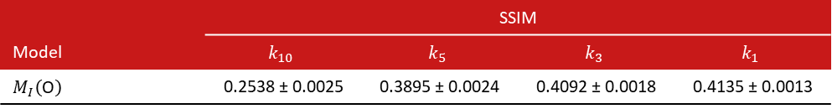



RQ2: Effect of Output Vector Truncation
 | SSIM
Model | $$k_{10}$$ | $$k_{5}$$ | $$k_{3}$$ | $$k_{1}$$
$M_{I}\left(\text{O}\right)$ | 0.2538 ± 0.0025 | 0.3895 ± 0.0024 | 0.4092 ± 0.0018 | 0.4135 ± 0.0013
Target
$$k_{10}$$
$$k_{5}$$
$$k_{3}$$
$$k_{1}$$

Slide 26
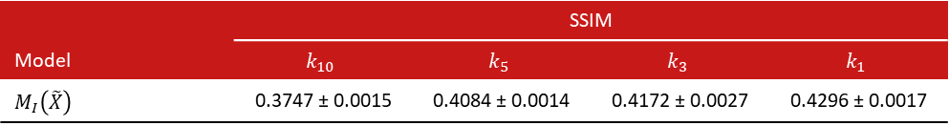
RQ2: Effect of Output Vector Truncation
 | SSIM
Model | $$k_{10}$$ | $$k_{5}$$ | $$k_{3}$$ | $$k_{1}$$
$M_{I}\left(\tilde{X}\right)$ | 0.3747 ± 0.0015 | 0.4084 ± 0.0014 | 0.4172 ± 0.0027 | 0.4296 ± 0.0017
Target
$$k_{10}$$
$$k_{5}$$
$$k_{3}$$
$$k_{1}$$

Slide 27
Limitations
Limited generalizability
Performance unknown on more complex datasets
Simple model architectures
Response on complex models ResNet, EfficientNet unknown
Attacker assumptions
Access to dataset from same distribution as target model
Exact architecture known

Slide 28

Future Work
Dataset variety
CIFAR-10, ImageNet
Extracting additional info from Shadow model
last feature map
Defence mechanisms:
noise to output vector
Student model

Slide 29
Thank You

